Slide 1
Rational Exponents and Radical Functions
Algebra 2
Chapter 6
Notes:
Algebra II 6

Slide 2
This Slideshow was developed to accompany the textbook
  Larson Algebra 2
  By Larson, R., Boswell, L., Kanold, T. D., & Stiff, L.
  2011 Holt McDougal
Some examples and diagrams are taken from the textbook.
Slides created by
Richard Wright, Andrews Academy
rwright@andrews.edu

Slide 3

6.1 Evaluate n^{th} Roots and Use Rational Exponents
Root
  If a² = b, then a is a square (2nd) root of b
  If a^{n} = b, then a is the n^{th} root of b
Parts of a radical
$$\sqrt[3]{64}$$
Radical Sign
Index
Radicand

Slide 4
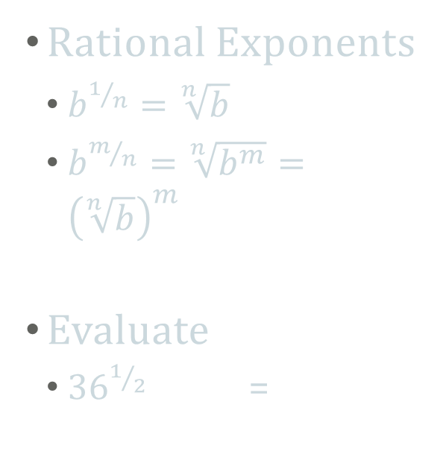

6.1 Evaluate n^{th} Roots and Use Rational Exponents
Rational Exponents
  $b^{1/n}=\sqrt[n]{b}$
  $b^{m/n}=\sqrt[n]{b^{m}}={\left(\sqrt[n]{b}\right)}^{m}$
Evaluate
  ${36}^{1/2}$ =
$\sqrt{36}$ =
±6
Notes:
√36 = 6

Slide 5






6.1 Evaluate n^{th} Roots and Use Rational Exponents
${\left(\frac{1}{8}\right)}^{−\frac{1}{3}}$ =
${27}^{\frac{4}{3}}$ =
${\left(8\right)}^{\frac{1}{3}}$ =
$\sqrt[3]{8}$ = $\sqrt[3]{2∗2∗2}$
= 2
$\sqrt[3]{{27}^{4}}$ =
$$\sqrt[3]{{(3∗3∗3)}^{4}}$$
= $3^{4}$ = 81
Notes:
³√(1/8)⁻¹ = ³√8 = 2
³√27⁴ = 3⁴ = 81

Slide 6
6.1 Evaluate n^{th} Roots and Use Rational Exponents
To find the roots by hand
  Find the prime factorization of the radicand
  Group the prime factors into groups of the same factor. Each group should have as many factors as the index.
  For each complete group, you can move that factor out of the radical once (the group becomes one number)
  If the index is even and the radicand is negative, the roots are not real

Slide 7
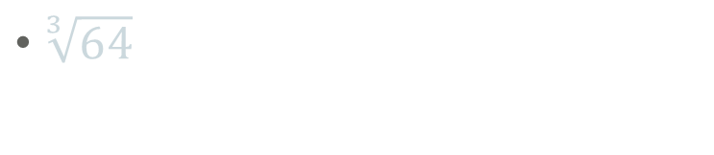


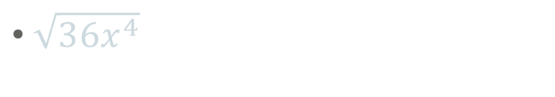
6.1 Evaluate n^{th} Roots and Use Rational Exponents
$\sqrt[3]{64}$
$\sqrt{36x^{4}}$
$$=\sqrt[3]{4∗4∗4}$$
$$= \sqrt{6∗6∗x∗x∗x∗x}$$
= 4
= 6x²
Notes:
³√64 = ³√4*4*4 = 4
√36x⁴ = √2*2*3*3*x*x*x*x = √(2*2)*(3*3)*(x*x)*(x*x) = 2*3*x*x = 6x²

Slide 8
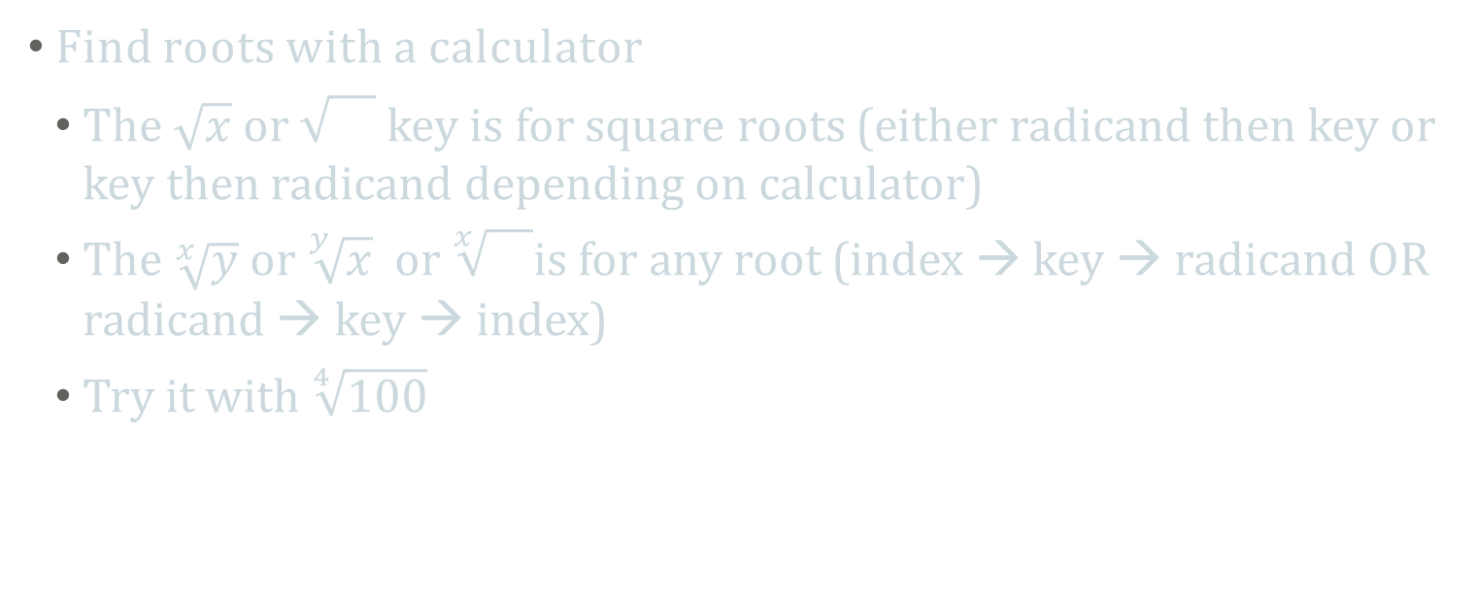
6.1 Evaluate n^{th} Roots and Use Rational Exponents
Find roots with a calculator
  The $\sqrt{x}$ or key is for square roots (either radicand then key or key then radicand depending on calculator)
  The $\sqrt[x]{y}$ or $\sqrt[y]{x}$ or $\sqrt[x]{}$is for any root (index → key → radicand OR radicand → key → index)
  Try it with $\sqrt[4]{100}$
Notes:
3.16

Slide 9

6.2 Apply Properties of Rational Exponents
Using Properties of Rational Exponents
  $x^{m}⋅x^{n}=x^{m+n}$
  ${\left(xy\right)}^{m}=x^{m}y^{m}$
  ${\left(x^{m}\right)}^{n}=x^{mn}$
  $\frac{x^{m}}{x^{n}}=x^{m−n}$
  ${\left(\frac{x}{y}\right)}^{m}=\frac{x^{m}}{y^{m}}$
  $x^{−m}=\frac{1}{x^{m}}$

Slide 10
6.2 Apply Properties of Rational Exponents
6^{1/2} ⋅ 6^{1/3}
  Rule: same base multiplying means add the exponents
  (27^{1/3}⋅6^{1/4})²
    Rule: exponent outside of parentheses, multiply powers
= 6^{1/2} ⁺ ^{1/3}
= 6^{5/6}
= 27^{(1/3)(2)} ⋅ 6(^{1/4)(2)}
⁼ 27^{2/3} ⋅ 6^{2/4}
= 27^{2/3} ⋅ 6^{1/2}
Notes:
6^{1/2 + 1/3} → 6^{3/6 + 2/6} → 6^{5/6}
(27^{1/3})² ⋅ (6^{1/4})² → 27^{2/3}⋅6^{1/2} → 9⋅6^{1/2}

Slide 11
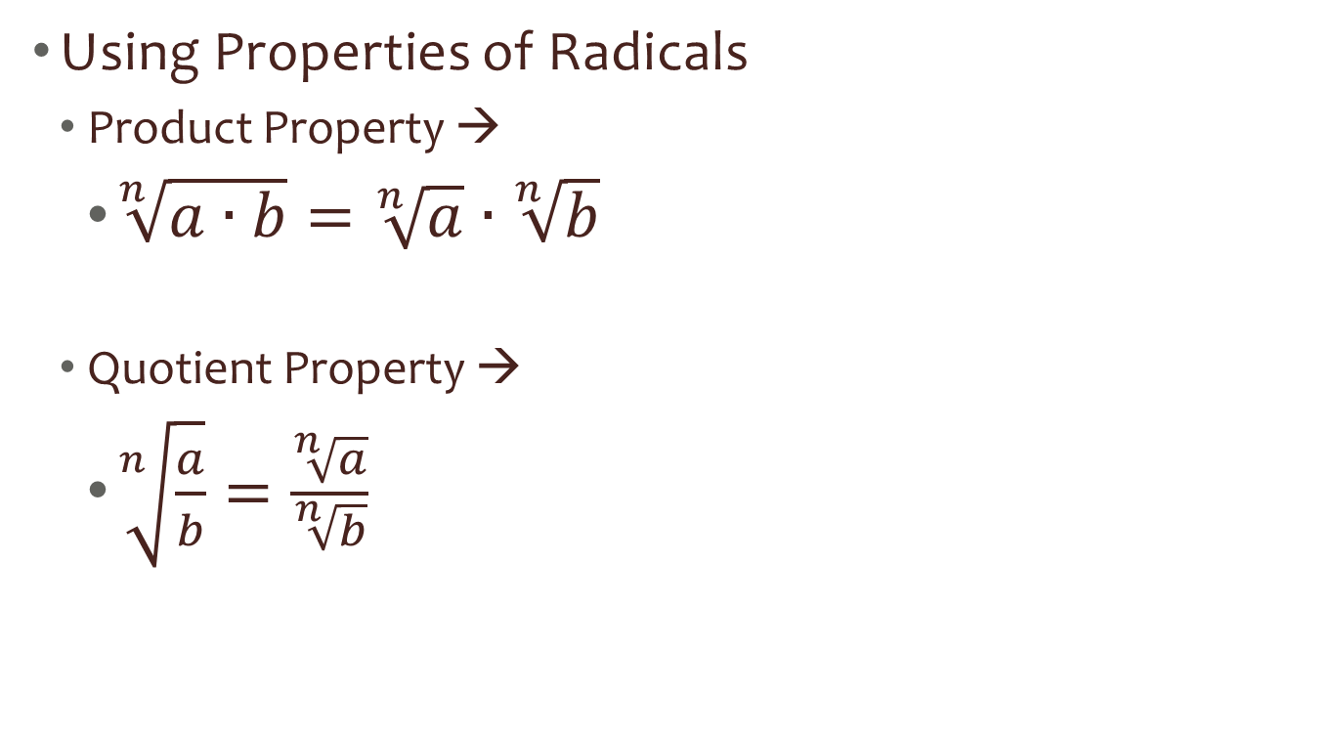
6.2 Apply Properties of Rational Exponents
Using Properties of Radicals
  Product Property →
    $\sqrt[n]{a∙b}=\sqrt[n]{a}∙\sqrt[n]{b}$
  Quotient Property →
    $\sqrt[n]{\frac{a}{b}}=\frac{\sqrt[n]{a}}{\sqrt[n]{b}}$

Slide 12
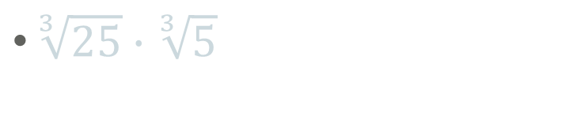



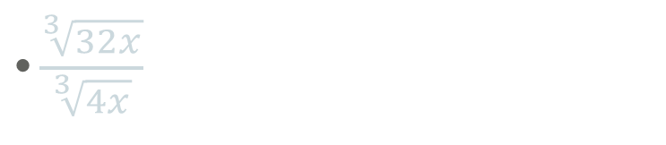
6.2 Apply Properties of Rational Exponents
$\sqrt[3]{25}∙\sqrt[3]{5}$
$\frac{\sqrt[3]{32x}}{\sqrt[3]{4x}}$
= $\sqrt[3]{5∗5}∙\sqrt[3]{5}$
= 5
$$= \frac{\sqrt[3]{2∗2∗2∗2∗2∗x}}{\sqrt[3]{2∗2∗x}}$$
= $\frac{8\sqrt[3]{4x}}{\sqrt[3]{4x}}$
= 8
Notes:
³√25*5 = ³√125 = 5
³√32x/4x = ³√8 = 2

Slide 13
6.6 Solve Radical Equations
Radical Equation
  Equation containing a radical
Steps
Isolate the radical
Raise both sides to whatever the index is (or the reciprocal of the exponent)
Solve
Check your answers!!!

Slide 14





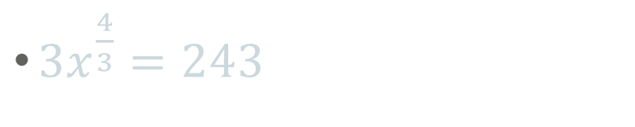

6.6 Solve Radical Equations
$5−\sqrt[4]{x}=0$
$3x^{\frac{4}{3}}=243$
$−\sqrt[4]{x}=0$ – 5
$$−\sqrt[4]{x}=−5$$
$$\sqrt[4]{x}=5$$
$$x^{\frac{4}{3}}=81$$
($x^{\frac{4}{3}})¾ =\left(81\right)¾$
($\sqrt[4]{x})4=\left(5\right)4$
$x$ = 625
$x$ = 81
Notes:
5=⁴√x → 5⁴ = x → x = 625
x^{4/3} = 81 → x = +-81^{3/4} = +-27

Slide 15

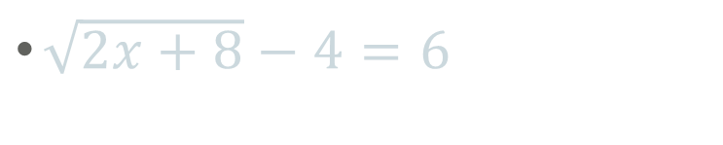



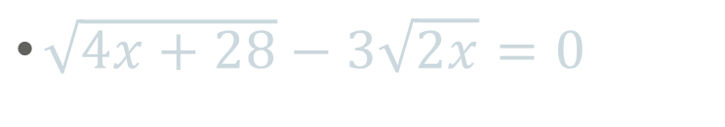

6.6 Solve Radical Equations
$\sqrt{2x+8}−4=6$
$\sqrt{4x+28}−3\sqrt{2x}=0$
$$\sqrt{2x+8}=10$$
$$\sqrt{4x+28}=3\sqrt{2x}$$
$$\left(\sqrt{4x+28}\right)2=(3\sqrt{2x)}2$$
$$\left(\sqrt{2x+8}\right)2=\left(10\right)2$$
4x + 28 $=9∗2x$
4x + 28 $=18x$
2x + 8 = 100
2x = 92
x = 46
28 = 14x
2 = x
Notes:
√(2x+8) = 10 → 2x+8 = 100 → 2x = 92 → x = 46
√(4x+28) = 3√(2x) → 4x+28 = 9(2x) → 4x+28 = 18x → 28 = 14x → x = 2

Slide 16





6.6 Solve Radical Equations
$$x+2=\sqrt{2x+28}$$
Factor or quadratic
Formula to solve:
$\left(x+6\right)$ $\left(x−4\right)$ = 0
x = -6, 4
$$\left(x+2\right)2=(\sqrt{2x+28})2$$
$x$² + 4 $x$ + 4 = 2 $x$ + 28
$x$² + 2$x$ - 24 = 0
Complete Final Exam Review Packet page 2
Notes:
(x+2)² = 2x+28 → x²+4x+4 = 2x+28 → x² +2x -24 = 0 → (x+6)(x-4) = 0 → x = -6, 4
Check
-6: -6+2 = √(2(-6)+28) → -4=√(-12+28) → -4 = 4 False
4: 4+2 = √(2(4)+28) → 6 = √36 → 6=6 True

